Slide 1
Leadership skills

Slide 2
Scenario
You are paged to a rapid response on a patient who is on the cardiology service.
While walking to the RRT you review the sign-out summary:
“81M admitted with SVT, stable on meds, dispo tomorrow”
Notes:
[ ] streamline to bullet points and simplify – ethan to help
[ ] add quiz element – ie show ekg, decide what to do – I can build this into website.
We like the rapid response pivot here because they are more ambiguous
How do you respond?
What do you do if the primary team comes?
What do you do if the ICU team comes?

Slide 3
Scenario
On entering the patient room you ask for the bedside RN, assign the medical student to pull up the EMR and the intern to start a brief physical exam.
The bedside RN states that he’s “been pretty tachy but was eye-balling okay until a few minutes ago. While I was getting an EKG, his SBP went from 120 to 95”
She hands you the EKG:
Notes:
[ ] streamline to bullet points and simplify – ethan to help
[ ] add quiz element – ie show ekg, decide what to do – I can build this into website.
We like the rapid response pivot here because they are more ambiguous
How do you respond?
What do you do if the primary team comes?
What do you do if the ICU team comes?

Slide 4
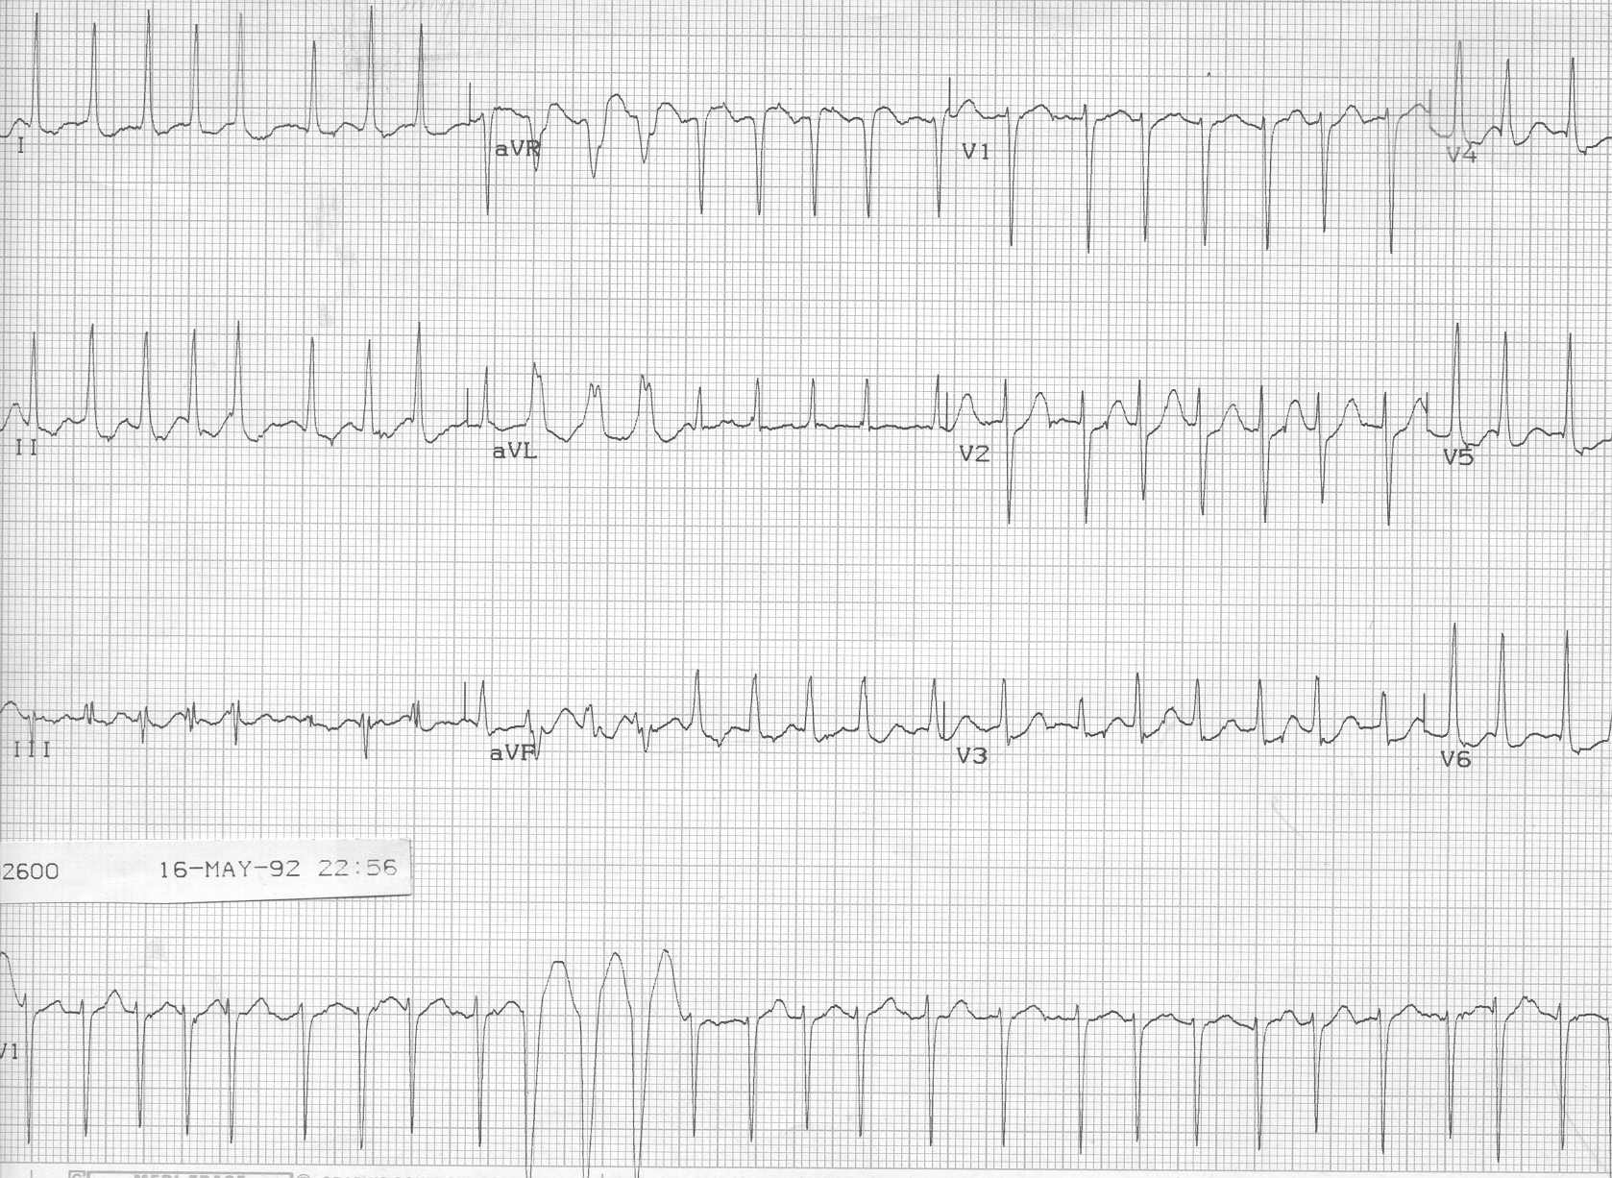
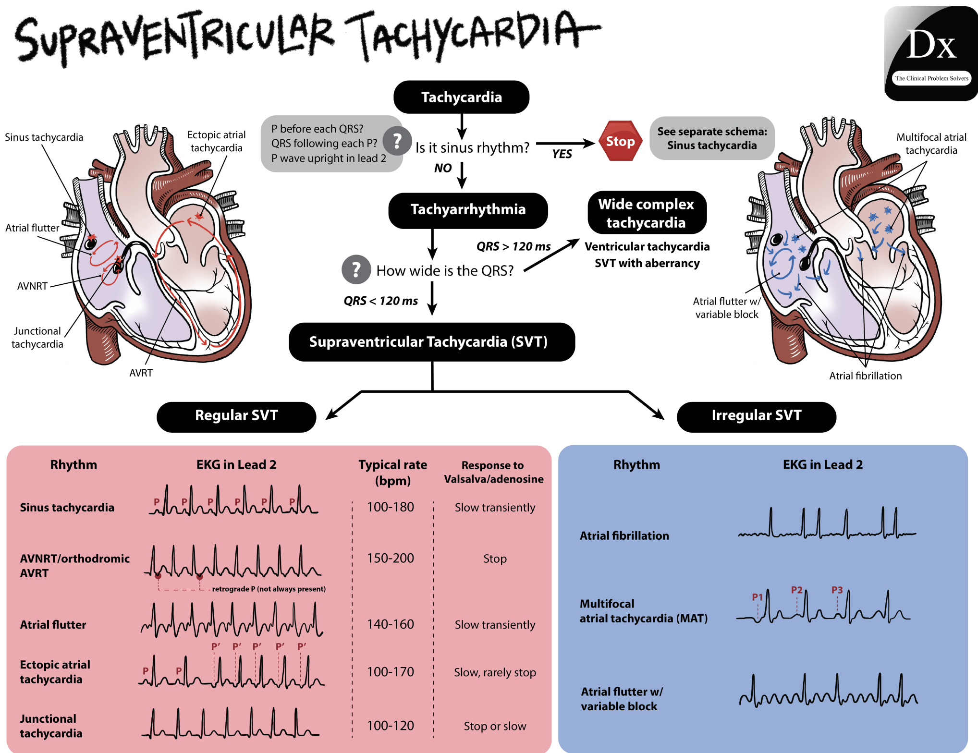
Notes:
AF with RVR (and abberancy)

Slide 5
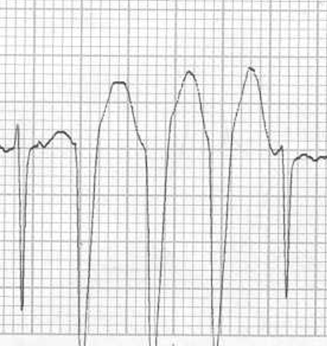
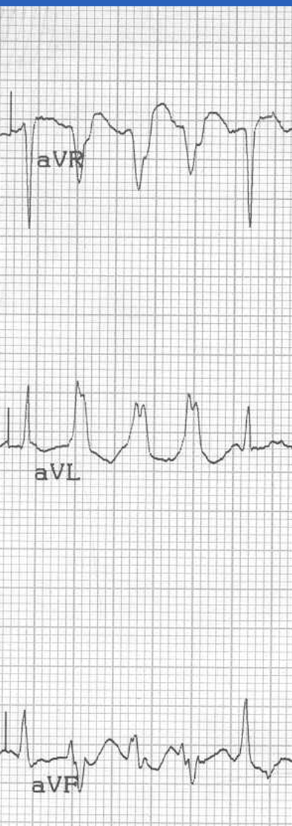
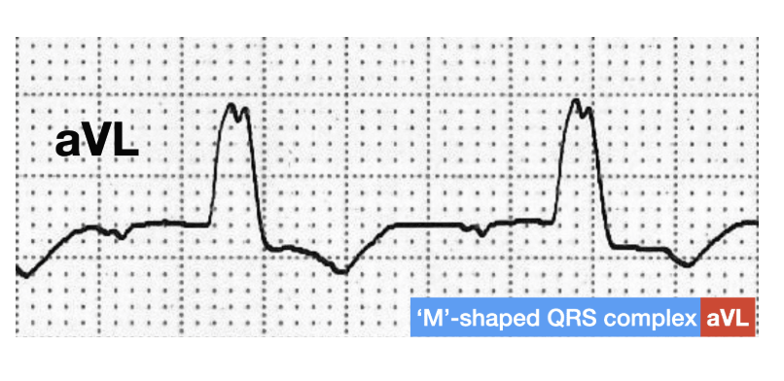
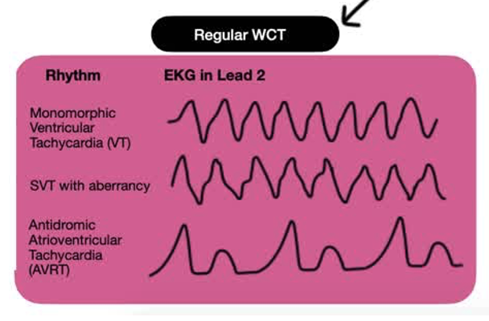
LBBB in aVL
Broad monophasic R wave in lateral leads
“wide-complex” (QRS > 120) + Regular
Answer:
AF + RVR
Bonus: + Aberrancy (LBBB)

Slide 6
Scenario
Framework?
→ Tachycardia with a pulse
More specific?
→ Narrow complex tachycardia with a pulse
MORE specific?
→ Narrow complex tachycardia + Pulse + Hemodynamically Stable/Unstable?
What does hemodynamic stability mean to you?
How does this inform treatment?
How do you convey this information and your thought process to the room?
Notes:
[
How do you respond?
What do you do if the primary team comes?
What do you do if the ICU team comes?

Slide 7
Scenario
While talking with the RN and RRT team you notice three individuals enter the room with “DOCTOR” on their badge standing aside quietly.
You don’t know these individuals, nor do they introduce themselves.

Slide 8
Scenario cont.
After getting the story and examining the patient, you decide to administer IV metoprolol.
You inform the bedside RN of your plan and then go to talk with the patient’s family to give them updates on the situation.
While you’re walking out of the room you hear the RN ask “what dose?” But you are quickly confronted by multiple family members.

Slide 9
Scenario cont.
Five minutes later, the intern pulls you away from the family because the patient’s HR dropped and his SBP is now 75.
They hand you an EKG:

Slide 10
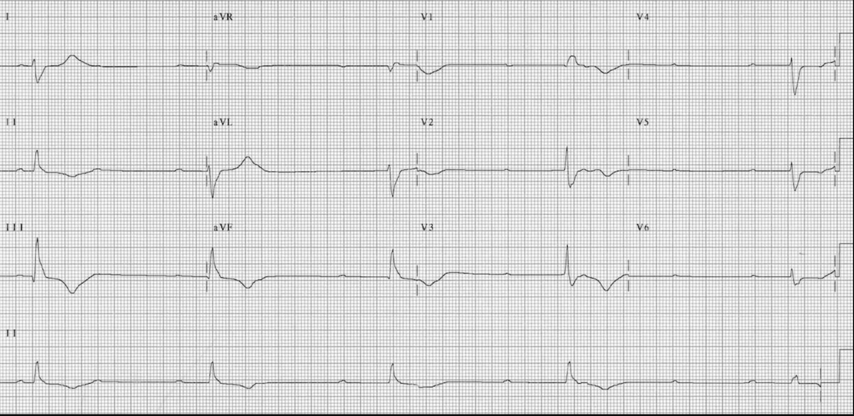
Escape Rhythms + Origin:
The rate of spontaneous depolarization of pacemaker cells decreases down the conducting system:
SA node (60-100 bpm)
Atria (< 60 bpm)
AV node (40-60 bpm)
Ventricles (20-40 bpm)
Atrial Rate?
~60 bpm
Interpretation?
Complete Heart Block with Ventricular Escape
Ventricular Rate?
~27 bpm
Notes:
Complete Heart Block:
Atrial rate is ~ 60 bpm
Ventricular rate is ~ 27 bpm
None of the atrial impulses appear to be conducted to the ventricles
There is a slow ventricular escape rhythm

Slide 11
Scenario cont.
What RRT/ACLS framework are you considering?
What are the next steps you consider?
Do you say this out loud in your summary to the RRT personnel?

Slide 12
Scenario cont.
You request atropine be given.
The RRT RN asks “what dose?”
You reply “0.5mg bolus once”
10-15 minutes go by without improvement, during which you requested an additional 0.5mg bolus 3 times.
You are monitoring the doses given and counting the total outload.
The intern asks you how much total atropine can be given?

Slide 13
Scenario cont.
There is no improvement.
What are your next steps?
How to you utilize your resources and personnel?

Slide 14
Scenario cont.
You start transcutaneous pacing to increase his heart rate and transfer him to the ICU
Brief Review of Transcutanous Pacing:

Slide 15
Debrief
While reviewing the case later you realize the patient was given three different doses of metoprolol instead of the one you verbally ordered.
You call the bedside RN to discuss and she lets you know that two other doctors came up to her after you and also told her to give metoprolol so she gave three total doses.
You find out that the other doctors were the primary team resident and cardiology fellow and both of them were unaware that you were at the rapid response at all.

Slide 16
What went wrong?
Notes:
Lots to discuss here. Obvious answer is the rapid resident should have introduced themself to the room rather than just bedside RN and asked if any of the present physicians were already running the code.
They should also invite fellow team members to share information and work collectively on the care plan. Engaging the primary team in decision making is incredibly valuable.

Slide 17
Scenario - RECAP
On entering the patient room you ask for the bedside RN, assign the medical student to pull up the EMR and the intern to start a brief physical exam.
Thoughts on introduction and role setting?

Slide 18
Scenario - RECAP
While talking with the RN and RRT team you notice three individuals enter the room with “DOCTOR” on their badge standing aside quietly.
You don’t know these individuals, nor do they introduce themselves.
How do you manage this scenario?
What do you do if the primary team arrives?
What do you do if the MICU team arrives?

Slide 19
Scenario - RECAP
You inform the bedside RN of your plan and then go to talk with the patient’s family to give them updates on the situation.
While you’re walking out of the room you hear the RN ask “what dose?” But you are quickly confronted by multiple family members.

Slide 20
Effective Leadership Skills
Establish a clear leader
Collaborate and share information

Slide 21
1. Establish a clear leader: Are you running this code or not?
"I’m ________, the resident on the the Code/RR team. Is anyone running this code?"
Alternative:
“OK, I’m running this code” or “Can I take over?"
Notes:
If someone IS already running it – that’s OK. They often want to hand over. If they don’t, make yourself useful.
You just need to commit to saying this. Loudly, right when you enter the door.
Examples where this comes up

Slide 22
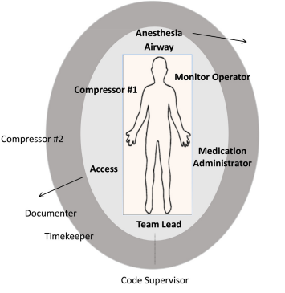
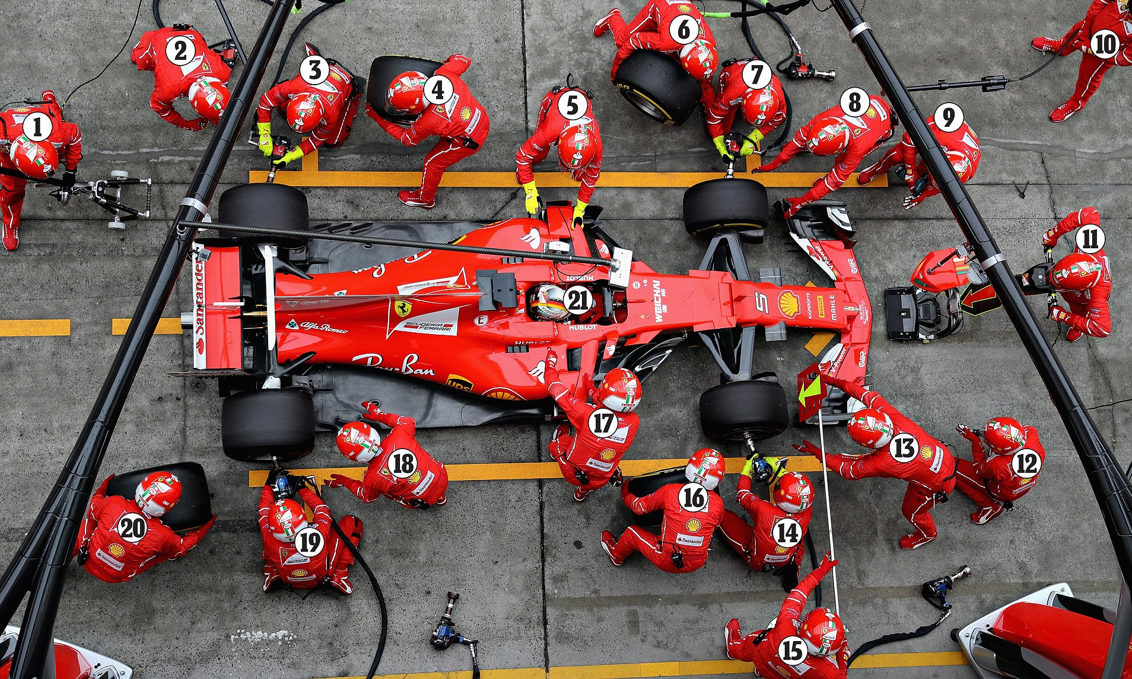
1. Establish a clear leader: Be the point person
https://doi.org/10.1016/j.resuscitation.2020.11.018
NEVER MOVE FROM HERE
DON’T DO IT
Notes:
I recommend foot over groin because it’s too tempting to do things at the groin
Closed Loop communication and delegation
Tell specific people to do specific things
Ask for closed loop communication.
Park yourself at the foot of the bed (do NOT do any tasks unless there are <4 people present)
feet in a power pose – power posing is bullshit and won’t change how you feel, but it will change how other people perceive you.
+/-ACLS card in front of you.
Direct traffic.
If someone asks for a task you agree with, say "Yes, <repeat it>" - all commands are coming from you.

Slide 23
2. Collaborate and share information: Invite suggestions by setting a constructive tone
Try this, not this …
- To establish leadership
To think out loud
We checked x,y,z.. Does anyone have thoughts?
To encourage open dialogue while maintaining leadership (conversation
Notes:
[We want to encourage actions rather than traits/characteristics]
Think out-loud (nobody’s perfect – enroll help)
- Give more encouragement than critique
Calm, collected, and in control
Modulate your voice; no yelling
Coach, don’t reprimand.
Give encouragement.
Lower the power difference
Some helpful phrases:
I’m going to summarize what I’m thinking…
Does anyone have any other ideas of things we might missing
“that’s a great point” …
Framework: goals that you want the team to perceive –
you’re open to input
You’re making unambiguous
- Folks understand your thinking
You can call for quiet to lower the noise level. Have folks step out if too crowded – you control the environment.
https://twitter.com/ross_prager/status/1769700101629399542?s=46&t=5eJ6uoTQrbbYTlHIOnRYRg – good thread with more detail and dope pixel art
What is the point of the bottom two?
Think of motivational interviewing with a patient.. You NEVER want to argue. You want to direct. Do the same thing here. You are directing a competent team of professionals who could do a pretty good job running a code on their own (they do in lots of places). Don’t break the machine – you want to productively guide it.
Fine V-Fib example. RN notices, but not empowered.

Slide 24
Scenario revisited
In an alternate universe, you are paged to the same rapid response – but this time you introduce yourself to the room on arrival and confirm with the primary team that they are happy to let you run the rapid. You stand at the head of the bed and collect information and suggestions from various team members.
The primary team resident suggests trying IV metoprolol x 1 to which you say “great idea”. After one dose of metoprolol the patients heart rate drops to ~120s and their blood pressure improves. They are transitioned to oral metoprolol and are able to stay on the floor without transferring to the ICU.
Notes:
Takeaway points:
Establish leadership
Think out loud
We checked x,y,z.. Does anyone have thoughts?
Encourage open dialogue while maintaining leadership (conversation

